Slide 1
Woodland Public Schools
Facilities and Safety Report
October 2019

Slide 2
FACILITIES REPORT
Automated Lockdown Announcement –IT has ordered the hardware required to start testing our ability to complete recorded announcements. Over the next couple of weeks, we will be looking into automating the lockdown announcements and delivering a prerecorded message over the building simplex system, when the lockdown buttons are depressed.
Yale School Fencing A PO was issued and work started on 11/19. I would expect this work to be completed in 1-2 weeks. This will add approximately 450 feet of fence, and completely enclose the sports field
Non-Student Days Oct. 31 and Nov. 1 – We took advantage of this time to complete some maintenance activities including:
Completed anchoring all equipment (seismic and tip over protection) in the WHS auto shop.
Installed 2 new water heaters; one at North Fork (unscheduled), and the second at WMS.
Completed the installation of the non-slip epoxy floor in the Middle School kitchen.
Completed elevator fire and recall test (NFE and WHS).
Started adding locking hardware to NFE classroom doors.
Installed 25 auto paper towel dispensers at NFE (same reasoning we did Columbia last year).

Slide 3
FACILITIES REPORT
Reunification Drill March 2020
Sent the first wave of email notifications to the staff, discussing the idea behind the reunification drill scheduled for March. Numerous communications will be sent to the staff and community over the next few months, to explain the drill and arrange for volunteers.
Solar Array Breaking Ground
I received the approved permit to start the mechanical installation of the solar array. Once the array is anchored, permits will be filed for the electrical side. The array will rest on the north end of the WHS property, on the south bank of the retention pond.

Slide 4
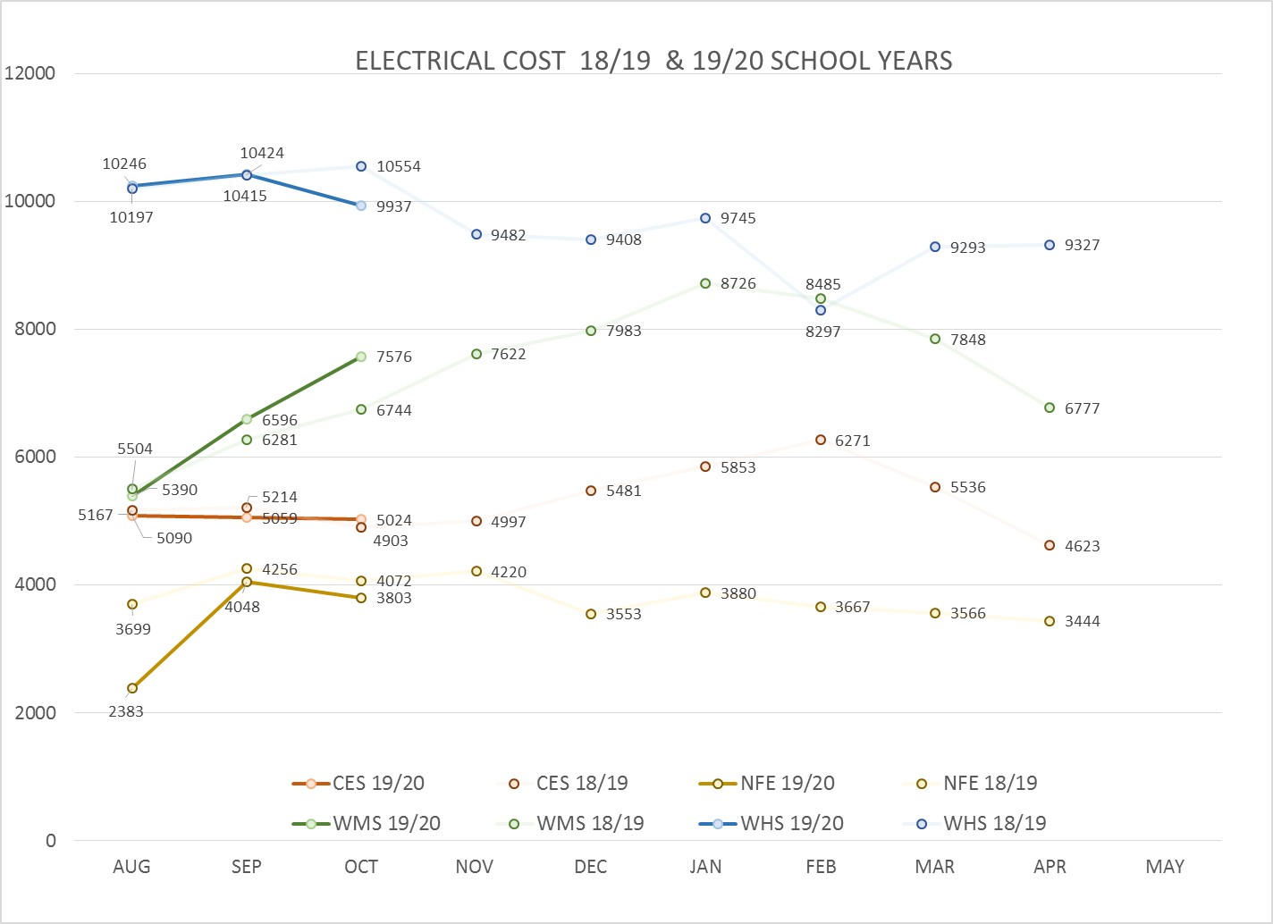
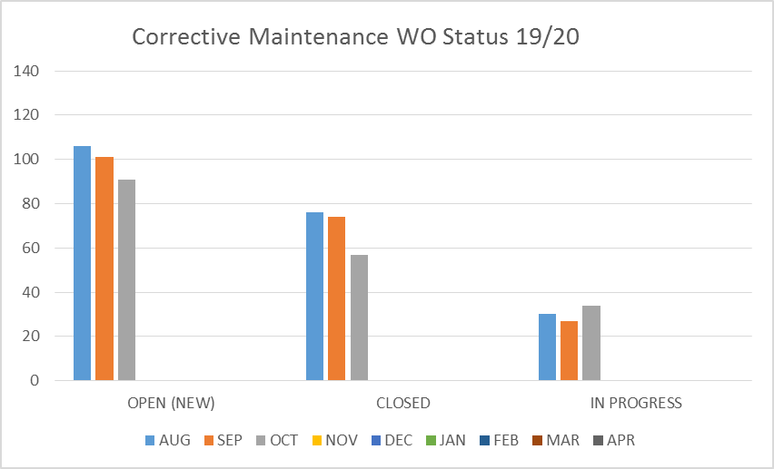
FACILITY CHARTS – POWER COST AND WORK ORDER STATUS

Slide 5
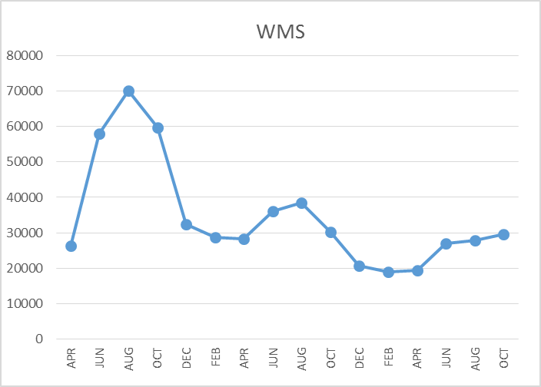
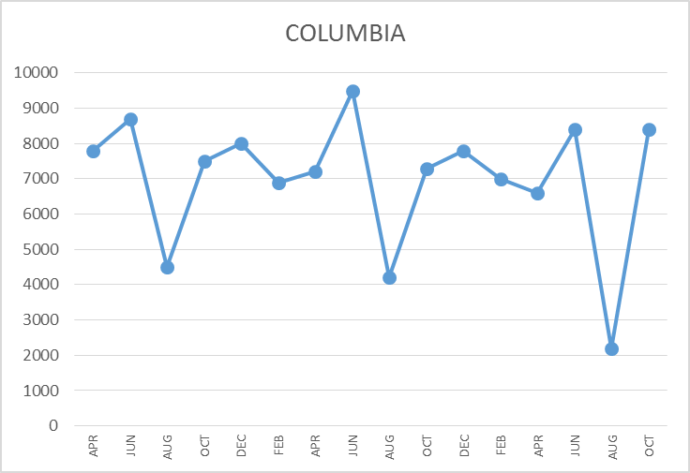
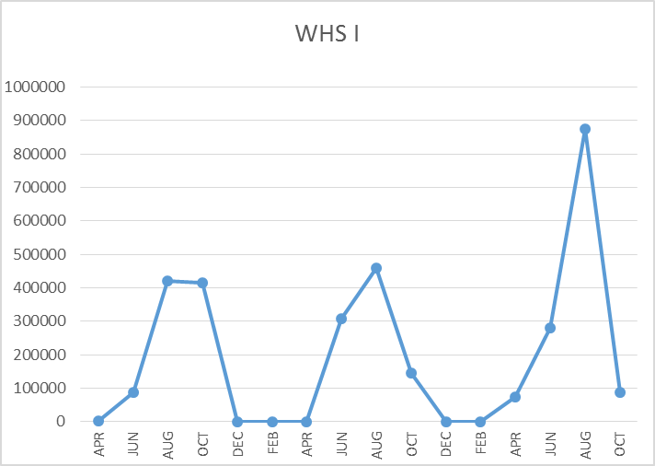
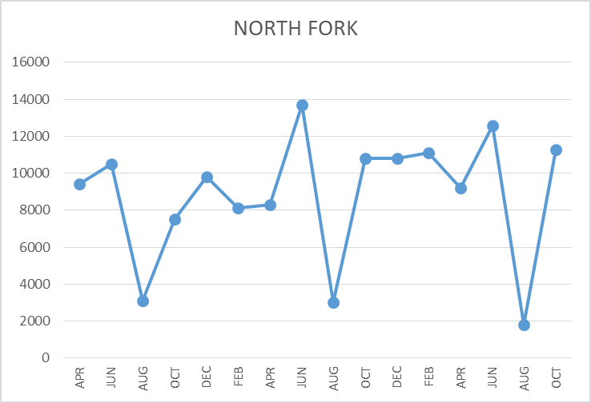
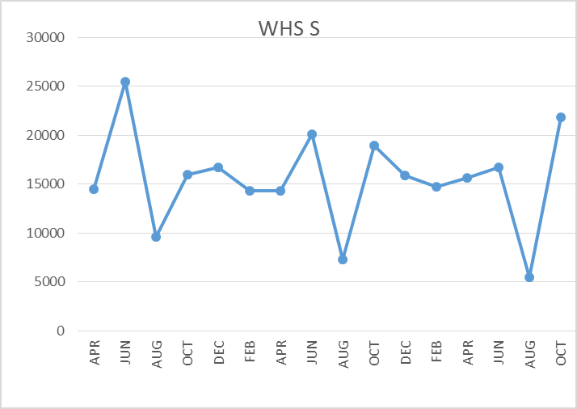
FACILITY CHARTS – WATER USAGE WHS, NFE, WMS, CES
Note
Water charts are updated every two
months. Next update to these charts
in January 2020
LEAK
REPAIRED
The WMS chart has been reconfigured to include the following 7 meters: 755 Park high and low flow, BO and Team High, PIT house, bus barn, athletic field and DO. All of these meters are totaled on the WMS graph, but each data point is recorded separately to aid in identifying leaks.

Slide 6
SAFETY SUMMARY
Staff Accidents/Incidents (5)
Yale – Box fell on employee’s leg- bruise.
Yale – Hit hand on counter when cleaning- bruise.
WMS- Tripped on bag she placed on floor- strained multiple areas.
CES- Escalated student head butted employee- head injury, no concussion.
CES- Tried to catch falling student- strained neck and shoulders.
Student Accidents/Injuries (7)
CES – Twisted foot in PE- fractured foot.
CES – Running on playground, slipped backwards, hit head-small laceration.
CES – Running with hands in coat and fell- 2 stiches on chin.
NFE – On playground, tripped over ball- laceration, chin and nose.
WMS – Soccer practice, student kicked in ankle- bruised ankle.
WMS – Back of leg strained during soccer practice.
WHS – Student sand blasted finger, due to worn gloves.

Slide 7
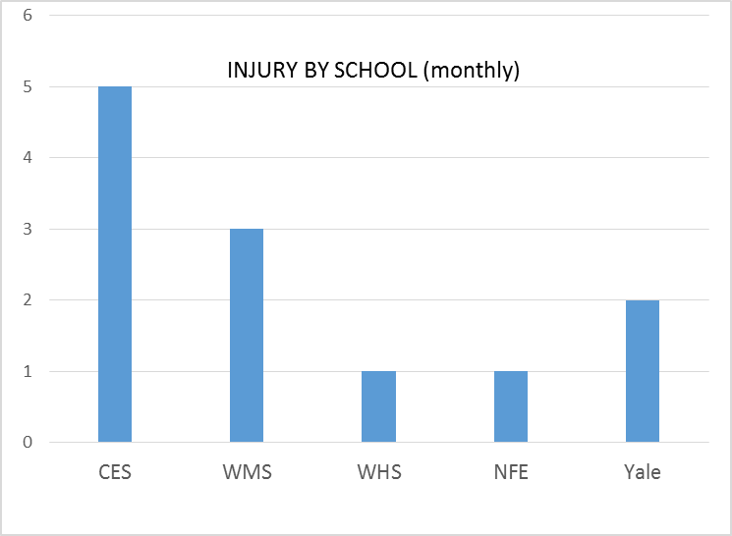
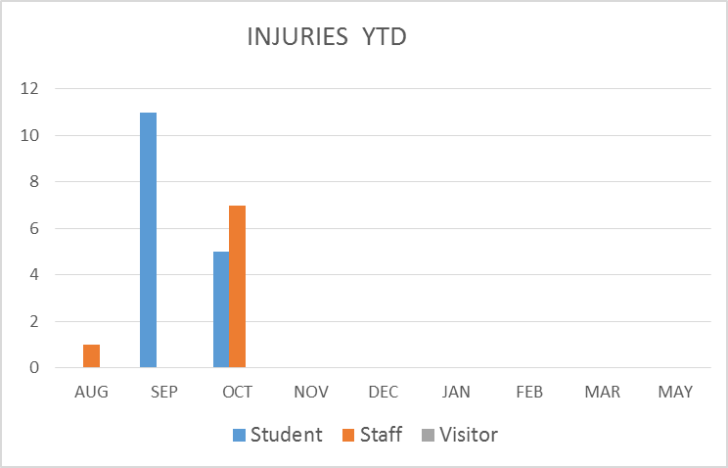
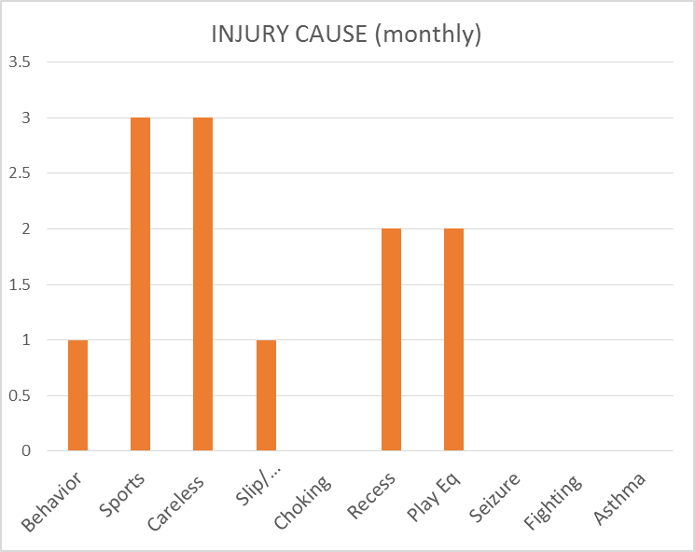
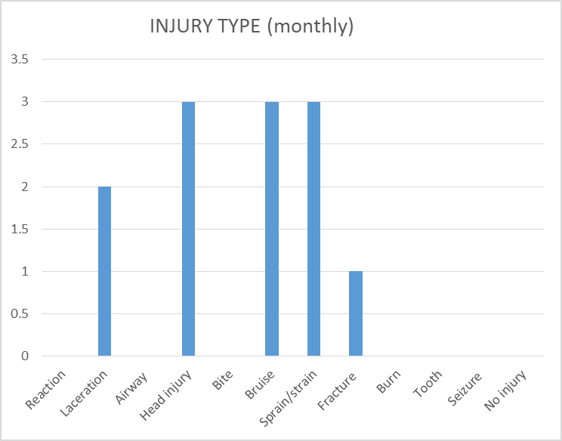
SAFETY CHARTS

